Slide 1
Smart Greenify Device
A project that helps in indoor planting!

Slide 2
Video Streaming with Raspberry pi Camera
Submitted by,
Anna Joy, C0769402
Group 1, Individual Meeting 4

Slide 3
Introduction
Smart Greenify is a device that helps indoor plants to survive without much effort from the owner.
So to make this more effective, there is an option for the users to monitor their plants wherever they are.
Video Streaming is introduced so that users can get live video of their plants.

Slide 4
Advantages of Video Streaming in this Project
1.Users can monitor the growth of the plants from anywhere, anytime.
2. Keep track of the health of the plants.
3.If it is used as a kitchen garden, users can estimate the time when they should harvest the vegetables.

Slide 5
Advantages of Video Streaming in this Project
4.Users can easily detect the diseases and do the needful.
5. If users find out the plants need more light or water they can remotely control it.

Slide 6
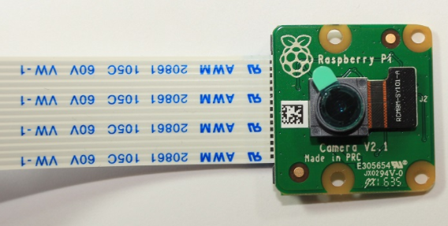
Camera Used: Raspberry pi Camera V2 Module

Slide 7
Camera Features
The Raspberry Pi Camera V2 features
an 8 megapixel Sony IMX219 image sensor with fixed focus lens
it is capable of 3280×2464 pixel static images
supports 1080p30, 720p60, and 640×480p90 video.

Slide 8
Enabling the Camera Module
To use the Raspberry Pi Camera module
enable the camera software in your Raspberry Pi.
In the Desktop environment
go to the Raspberry Pi Configuration => Preferences =>Interfaces tab =>enable the Camera.

Slide 9
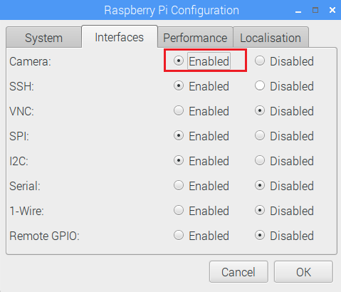
Enabling the Camera Module

Slide 10
Enabling the Camera Module
Or, in the Terminal window, type the following command:
pi@raspberry:~ $ sudo raspi-config
Select the Interfacing Options in Raspberry Pi software configuration tool

Slide 11
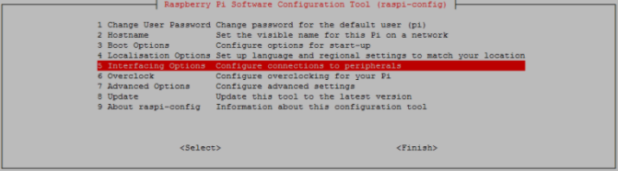
Enabling the Camera Module

Slide 12
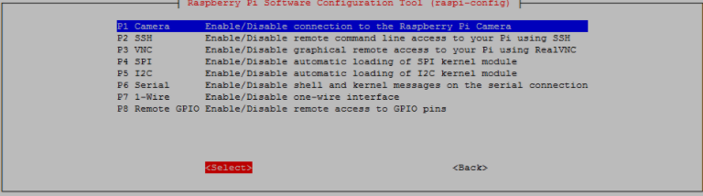
Enabling the Camera Module
Enable the camera and reboot your Pi:

Slide 13
Camera Connection
With the Pi shutdown,
connect the camera to the Pi CSI port.
Make sure the camera is connected in the right orientation with the ribbon blue letters facing up as shown in the next figure.

Slide 14
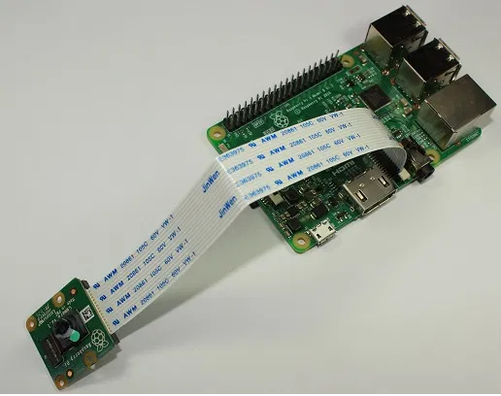
Camera Connection

Slide 15
Clicking Pictures
Create a new file called take_photo.py
pi@raspberrypi:~ $ nano take_photo.py
Copy the following code to your newly created file

Slide 16
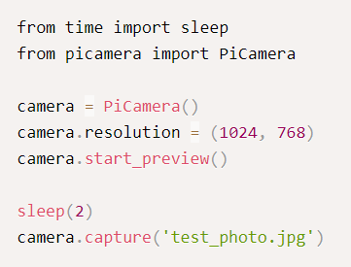
Clicking Pictures

Slide 17
Clicking Pictures
Press Ctrl+X to save your file, type Y and Enter.
When you run the script:
pi@raspberrypi:~ $ python3 take_photo.py
It takes a photo with the Raspberry Pi Camera and saves it with the test_photo.jpg name

Slide 18
Recording a Video into a File
Create a new file called record_video.py:
pi@raspberrypi:~ $ nano record_video.py
Copy the following code to newly created file

Slide 19
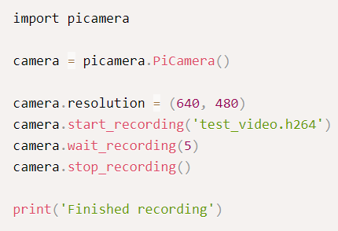
Recording a Video into a File

Slide 20
Recording a Video into a File
Press Ctrl+X to save your file, type Y and Enter.
When you run the script:
pi@raspberrypi:~ $ python3 record_video.py
It takes 5 seconds video with the Raspberry Pi Camera and saves it with the test_video.h264 name. You can modify the script to set the camera resolution and extend the video recording duration.

Slide 21
Recording a Video into a File
To watch the video on Raspberry Pi with the Raspbian Desktop environment, you can use the omxplayer software.
pi@raspberrypi:~ $ omxplayer test_video.h264

Slide 22
Video Streaming
Step:1
Create a new file called rpi_camera_surveillance_system.py:
pi@raspberrypi:~ $ nano rpi_camera_surveillance_system.py

Slide 23
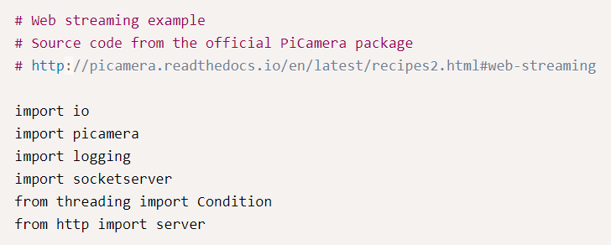
Video Streaming

Slide 24
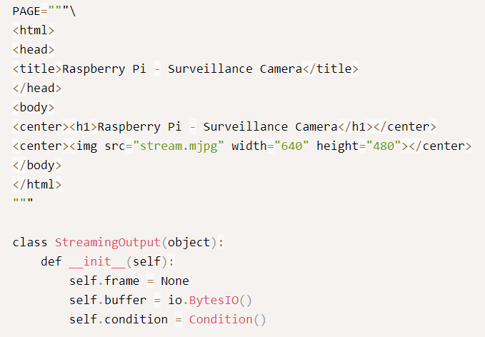

Slide 25
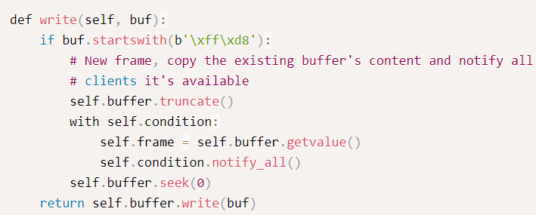

Slide 26
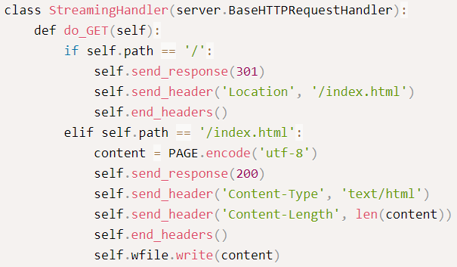

Slide 27
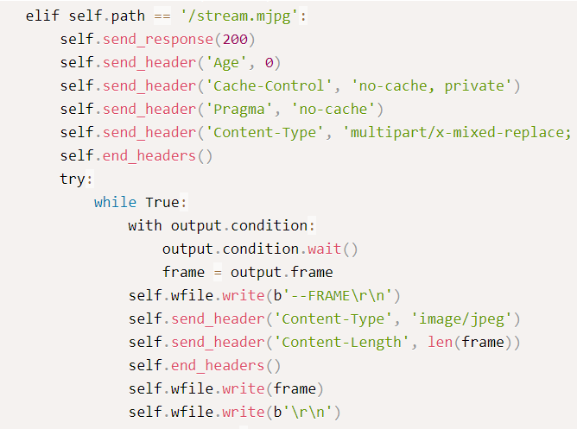

Slide 28
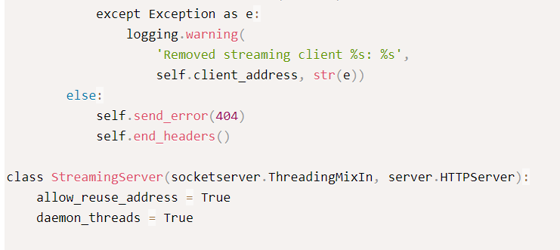

Slide 29
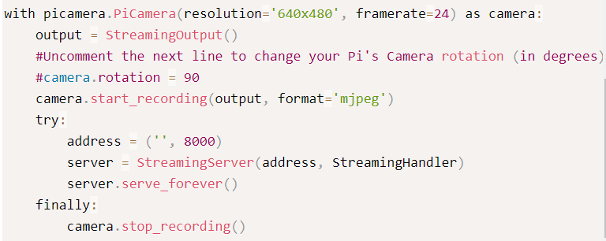

Slide 30
Accessing the video streaming
Run the command:
pi@raspberrypi:~ $ python3 rpi_camera_surveillance_system.py
The video streaming can be accessed through any device that has a browser and is connected to the same network that your Pi.
Once the script is running, the users can access the video streaming web server at: http://<Your_Pi_IP_Address>:8000.

Slide 31
How to Find the Raspberry Pi IP address
To find the Raspberry Pi IP address, we need to run the following command;
pi@raspberry:~ $ ifconfig

Slide 32
Thank you

Slide 33
References
Randomnerdtutorials.com. 2021. Video Streaming Raspberry Pi Camera | Random Nerd Tutorials. [online] Available at: <https://randomnerdtutorials.com/video-streaming-with-raspberry-pi-camera/> [Accessed 5 August 2021].
Picamera.readthedocs.io. 2021. 4. Advanced Recipes — Picamera 1.13 Documentation. [online] Available at: <https://picamera.readthedocs.io/en/latest/recipes2.html> [Accessed 5 August 2021].

Slide 34
References
3. Author, M., 2021. Raspberry Pi Video Streaming. [online] Instructables. Available at: <https://www.instructables.com/Raspberry-Pi-Video-Streaming/> [Accessed 5 August 2021].
4. Raspberry Pi Stack Exchange. 2021. How to stream video from Raspberry Pi camera and watch it live. [online] Available at: <https://raspberrypi.stackexchange.com/questions/23182/how-to-stream-video-from-raspberry-pi-camera-and-watch-it-live> [Accessed 5 August 2021].

